Slide 1

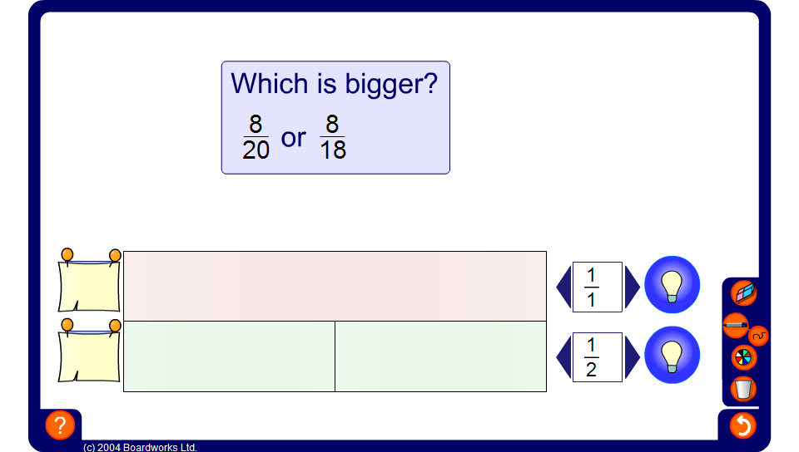


Using diagrams to compare fractions
Notes:
Use the diagram to compare the given fractions. Start by dividing each line into the correct number of equal parts and shading the required fraction.

